Slide 1
One note Chords
Ben Hartman

Slide 2
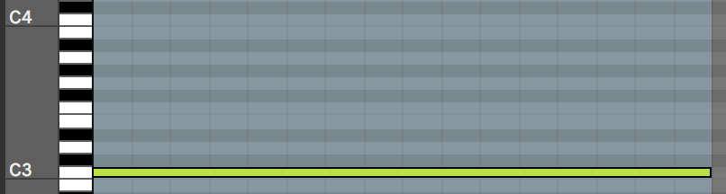
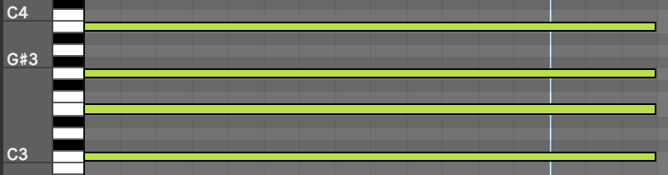
The Project
Create a project that turns single note input MIDI into triad and seventh chord outputs
Switch between different qualities of chords
Use real time MIDI input

Slide 3
Purpose
Make playing chord progressions easier for non-piano players
Speed up workflow

Slide 4
Start
Open MIDI Device, Input, + Output
Storage: Chord
User Input: What Quality of Chord (1-8)?
Enter Loop
Storage: MIDI IN
Retrieve MIDI Input
Enter Switch Statement
Add Chord intervals to MIDI Input + Output Result
No
Has output been produced?
Yes
Exit Loop + Close MIDI input + output

Slide 5
Software Implementation
Setup PortMIDI + PortTime
Start Timer
User input scale selection – stored int
Receive MIDI Note from controller
Select chord from switch statement using input scale selection
Outputs 3 or 4 notes as (rootnote + interval) in note on/off pairs
Stop timer + PortMIDI
Close it all

Slide 6
Setting Up
Requires PortMIDI + PortTime to be installed
Requires MIDI input device connected to computer
Input + Output device must be defined at the top of page
Specific MIDI Controller inputs and outputs need to be redefined at top of program

Slide 7
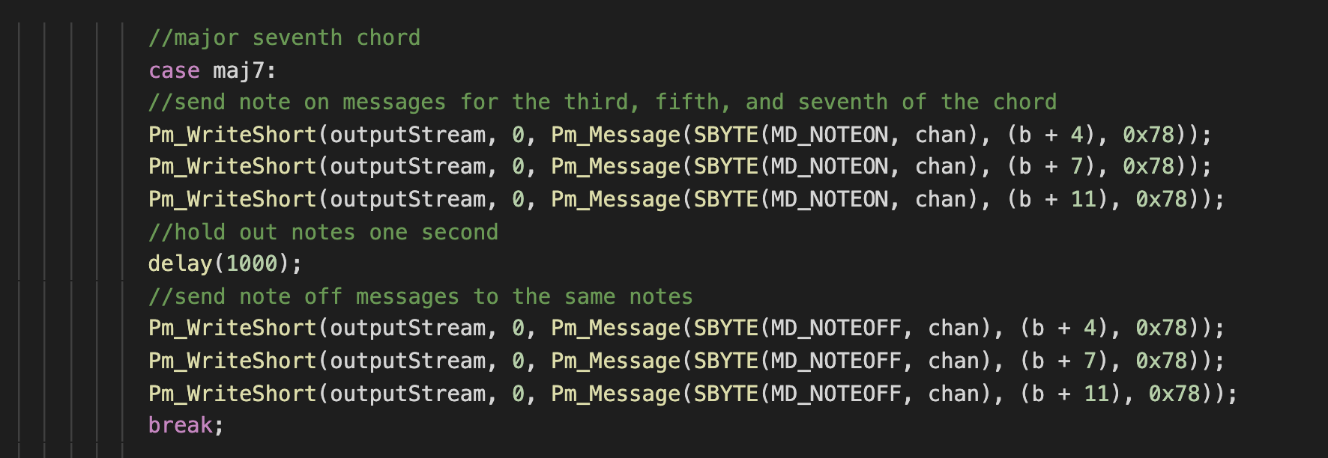
Demonstration

Slide 8
What Works?
MIDI Input
Chord selection and calculation
MIDI Output

Slide 9
What Needs Work?
Replace Switch Statement
MIDI Device selection in CLI
Replay chords multiple times
Stop loop with keyboard
Modes

Slide 10
One note Chords

